Slide 1
Chapter 4
Compute Architecture and Scheduling

Slide 2
GPU Architecture
A GPU consists of multiple Streaming Multiprocessor (SMs), each consisting of multiple cores with shared control and memory
(e.g., a Volta V100 GPU has 80 SMs with 64 cores each which totals 5120 cores)
SM
SM
SM
SM
Control
Control
Control
Control
Core
Core
Core
Core
Core
Core
Core
Core
Core
Core
Core
Core
Core
Core
…
Core
Core
Core
Core
Core
Core
Core
Core
Core
Core
Core
Core
Core
Core
Core
Core
Core
Core
Memory
Memory
Memory
Memory
Global Memory

Slide 3
Assigning Blocks to SMs
Threads are assigned to SMs at block granularity
(all threads in a block are assigned to the same SM)
Threads/blocks require resources to execute (e.g., registers, memory, …) so SMs can accommodate a limited number of threads/blocks at once…
… The remaining blocks wait for other blocks to finish before they can be assigned to an SM.
SM
SM
SM
SM
Control
Control
Control
Control
Core
Core
Core
Core
Core
Core
Core
Core
Core
Core
Core
Core
Core
Core
…
Core
Core
Core
Core
Core
Core
Core
Core
Core
Core
…
Core
Core
Core
Core
Core
Core
Core
Core
Waiting
Memory
Memory
Memory
Memory

Slide 4
Synchronization
Threads in the same block can collaborate in ways that threads in different blocks cannot:
Barrier synchronization: __syncthreads()
Wait for all threads in the block to reach the barrier before any thread can proceed
Shared memory (discussed later)
Access a fast memory that only threads in the same block can access
Others (discussed later)

Slide 5

Scheduling Considerations
Threads in the same block are assigned to the same SM
Assigning threads in the same block to the same SM makes supporting collaboration between them efficient
SM
SM
SM
SM
Control
Control
Control
Control
Core
Core
Core
Core
Core
Core
Core
Core
Core
Core
Core
Core
Core
Core
…
Core
Core
Core
Core
Core
Core
Core
Core
Core
Core
Core
Core
Core
Core
Core
Core
Core
Core
Memory
Memory
Memory
Memory

Slide 6
Scheduling Considerations
All threads in a block are assigned to an SM simultaneously
A block cannot be assigned to an SM until it secures enough resources for all its threads to execute
SM
SM
SM
SM
Control
Control
Control
Control
Otherwise, if some threads reach a barrier and others cannot execute, the system could deadlock
Core
Core
Core
Core
Core
Core
Core
Core
Core
Core
Core
Core
Core
Core
…
Core
Core
Core
Core
Core
Core
Core
Core
Core
Core
Core
Core
Core
Core
Core
Core
Core
Core
Memory
Memory
Memory
Memory

Slide 7
Transparent Scalability
Threads in different blocks do not synchronize
Allows blocks to execute in any order
Allows blocks to execute both in parallel with each other or sequentially with respect to each other
Enables transparent scalability
Same code can run on different devices with different amounts of hardware parallelism
Execute blocks sequentially if device has few SMs
Execute blocks in parallel if device has many SMs
Programmers should not write code that tries to synchronizes across blocks
Deadlock occurs if the blocks are not scheduled simultaneously
Note: cooperative groups is an advanced feature of CUDA that allows synchronization across blocks by limiting the number of blocks to guarantee that all blocks are executing simultaneously

Slide 8
Thread Scheduling
Threads assigned to an SM run concurrently
The SM has a scheduler that manages their execution
Blocks assigned to an SM are further divided into warps which are the unit of scheduling
SM
SM
Control
Control
Core
Core
Core
Core
Core
Core
Core
Core
Core
Core
Core
Core
Core
Core
Core
Core
Memory
Memory

Slide 9
Warps
Warps are the unit of scheduling in an SM
The size of warps is device-specific, but has always been 32 threads to date
Threads in a warp are scheduled together and executed following the SIMD model
Single Instruction, Multiple Data
One instruction is fetched and executed by all the threads in the warp, each processing different data
SM
Control
Core
Core
Core
Core
Core
Core
Core
Core
Memory

Slide 10
Why SIMD?
Advantage of SIMD:
Share the same instruction fetch/dispatch unit across multiple execution units (cores)
i.e., amortizes the cost of control across more execution units

Slide 11
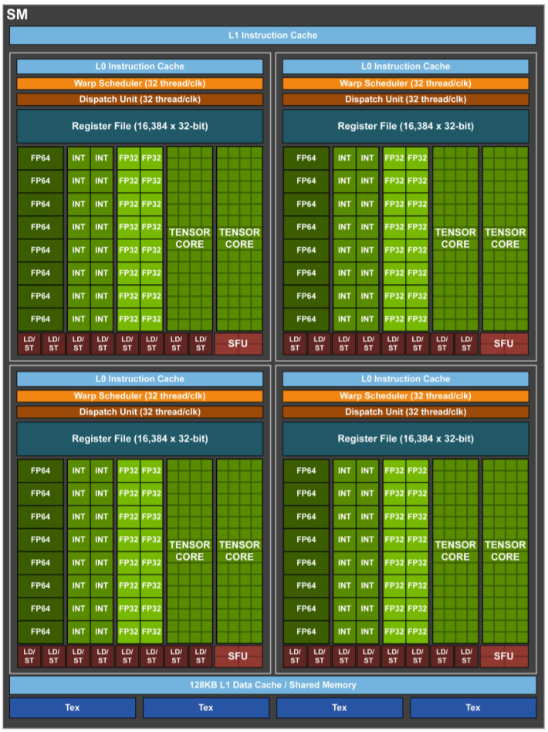
Real Stuff
Example: Volta V100 GPU
SM has 64 FP32 cores
Organized into 4 processing blocks
Each processing block has 16 cores that share a dispatch unit
A warp is executed by one processing block
Source:
NVIDIA Tesla V100 GPU Architecture, 2017

Slide 12
Why SIMD?
Advantage of SIMD:
Share the same instruction fetch/dispatch unit across multiple execution units (cores)
i.e., amortizes the cost of control across more execution units
Disadvantage of SIMD:
Different threads taking different execution paths result in control divergence
Warp does a pass over each unique execution path
In each pass, threads taking the path execute while others are disabled
The percentage of threads/cores enabled during SIMD execution is called the SIMD efficiency

Slide 13
Control Divergence Example
0 1 2 3 23 24 25 31
Example 1: Threads take different branches of a conditional
…
…
if(threadIdx.x < 24) {
A
} else {
B
}
C
…
…
inactive
…
…
inactive
…
…
…
…

Slide 14
Control Divergence Example
0 1 2 4 5 6 7 31
Example 2: Threads execute a different number of loop iterations
…
N = a[threadIdx.x];
for(i = 0; i < N; ++i) {
A
}
8 6 7 4 5 6 8 7 N
…
…
…
…
…
…
…
…

Slide 15
Latency Hiding
When a warp needs to wait for a high latency operation, another warp that is ready is selected and scheduled for execution
Core
Core
Core
Core
Core
Core
Core
Core
…
…
SM
🕑 long-latency operation
Control
…
Core
Core
…
…
Core
Core
🕑 long-latency operation
…
Core
Core
🕑 long-latency operation
…
…
Core
Core
🕑 long-latency operation
…
Memory
…

Slide 16
Latency Hiding
When a warp needs to wait for a high latency operation, another warp that is ready is selected and scheduled for execution
Many warps are needed so that there is sufficient work available to hide long latency operations
i.e., there is high chance of finding a warp that is ready
For this reason, an SM typically supports many more threads than the number of cores it has

Slide 17
SM Resources
GPU Name | K40 | M40 | P100 | V100
Microarchitecture | Kepler | Maxwell | Pascal | Volta
Compute Capability | 3.5 | 5.2 | 6.0 | 7.0
Number of SMs | 15 | 24 | 56 | 80
Cores per SM | 192 | 128 | 64 | 64
Max threads per SM | 2048 | 2048 | 2048 | 2048
Max blocks per SM | 16 | 32 | 32 | 32
Max threads per block | 1024 | 1024 | 1024 | 1024
Registers per SM | 64K | 64K | 64K | 64K
Shared memory per SM | 48KB | 96KB | 64KB | 96KB
Max threads per SM is much higher than cores per SM

Slide 18
Occupancy
The occupancy of an SM refers to the ratio of the warps or threads active on the SM to the maximum allowed
In general, maximizing occupancy is desirable because it improves latency hiding
Common case, but possible to have cases where lower occupancy is desirable

Slide 19
Occupancy Constraints
GPU Name | K40 | M40 | P100 | V100
Microarchitecture | Kepler | Maxwell | Pascal | Volta
Compute Capability | 3.5 | 5.2 | 6.0 | 7.0
Number of SMs | 15 | 24 | 56 | 80
Cores per SM | 192 | 128 | 64 | 64
Max threads per SM | 2048 | 2048 | 2048 | 2048
Max blocks per SM | 16 | 32 | 32 | 32
Max threads per block | 1024 | 1024 | 1024 | 1024
Registers per SM | 64K | 64K | 64K | 64K
Shared memory per SM | 48KB | 96KB | 64KB | 96KB
Choice of threads per block constrains occupancy

Slide 20
Occupancy Example
Volta V100 supports up to: 1024 threads/block 2048 threads/SM, and 32 blocks/SM
If 256 threads/block are used, occupancy is maximized
(2048 threads)/(256 threads/block) = 8 blocks < 32 blocks
If 32 threads/block are used, the occupancy will be limited by the number of blocks allowed
(2048 threads)/(32 threads/block) = 64 blocks > 32 blocks
If 768 threads/block are used, occupancy will be limited because 2048 is not evenly divisible by 768
(2048 threads)/(768 threads/block) = 2 blocks
The remaining 512 cannot be used

Slide 21
Querying Available Resources
Programmers can query the properties of a device to identify its available resources
cudaError_t cudaGetDeviceProperties(cudaDeviceProp* prop, int device)
Example:
int devID = 0;
cudaDeviceProp devProp;
cudaGetDeviceProperties(&devProp, devID);
int maxThreadsPerBlock = devProp.maxThreadsPerBlock;
int maxThreadsPerMultiProcessor = devProp.maxThreadsPerMultiProcessor;

Slide 22
References
Wen-mei W. Hwu, David B. Kirk, and Izzat El Hajj. Programming Massively Parallel Processors: A Hands-on Approach. Morgan Kaufmann, 2022.

